Slide 1
Artist Book/Art Journal Grade 9-12
By: Lyce Rohde

Slide 2
BELLWORK
What function do books have?
Name all the types of books you know. (not genres of literature)

Slide 3
WHAT IS AN ARTISTS BOOK?
Artists' Books are works of art realized in the form of a book.
They have a theme or general idea throughout.

Slide 4
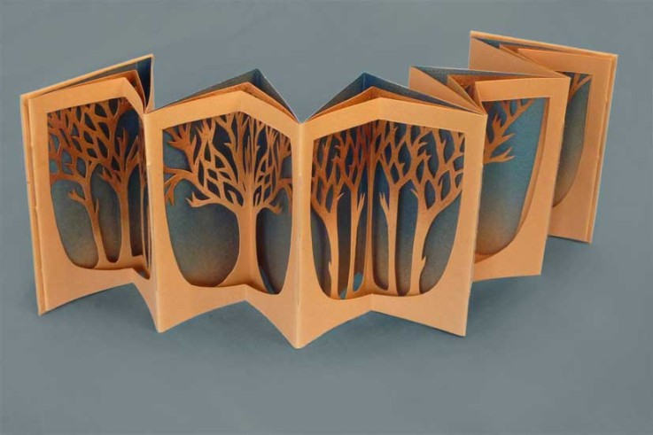
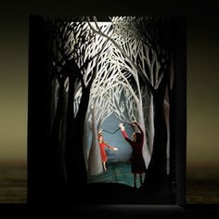

Slide 5
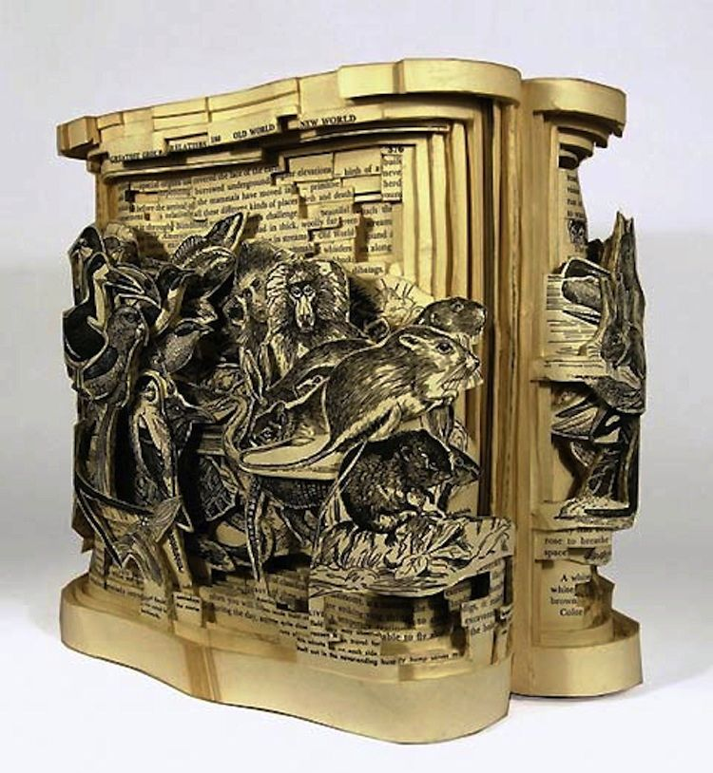
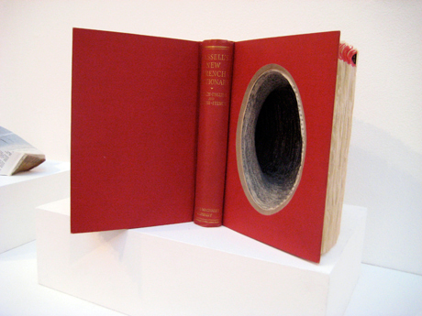

Slide 6
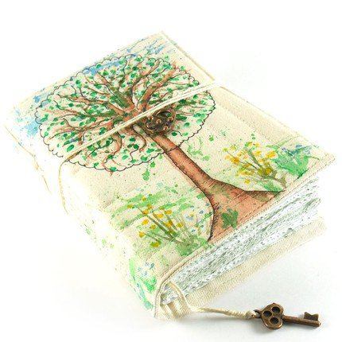
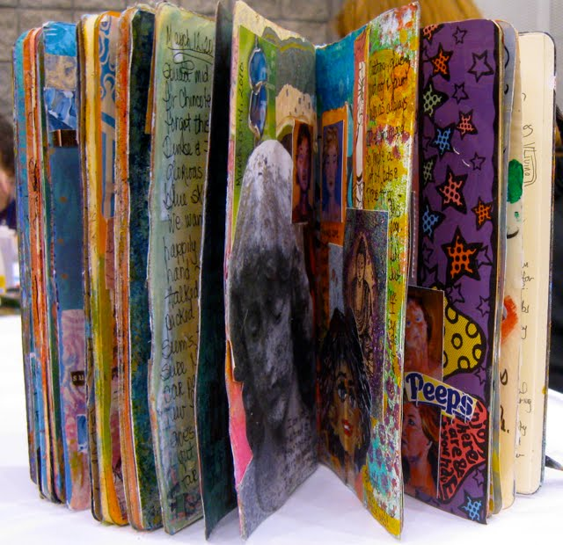

Slide 7
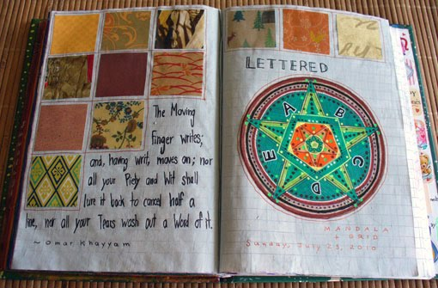
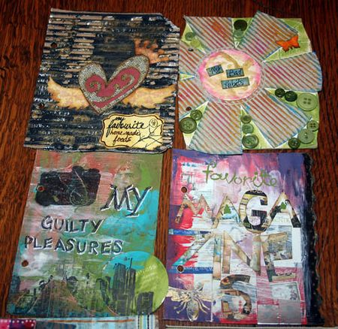
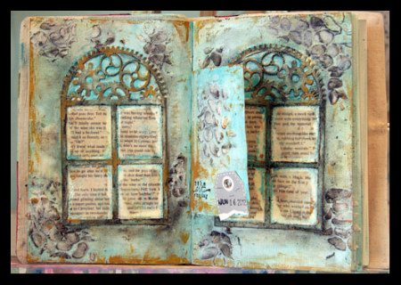

Slide 8
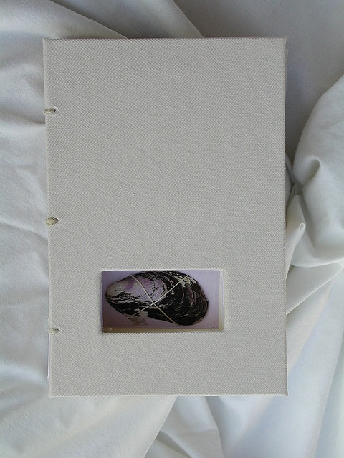
We will be making a variation of this!

Slide 9
BOOK CONSTRUCTION

Slide 10
Criteria
A book no smaller than 3”x3” in size.
10 page minimum in text block.
The pages and covers must be decorated.
USB Drive must be adhered and inside the cutout of the book.
There must be a cohesive theme between the objects and the pages they are on

Slide 11
RESEARCH AND THUMBNAIL SKETCHES
Need more inspiration? Do some research to get ideas. Write down or print out ideas and put them in the your class notebook/sketchbook.
Figure out the size of your Art Journal.
How big for the opening in the Journal?
Start Thumbnail sketches of ideas for the inside pages of the journal.
What is the theme?
INFORMATION WILL BE CHECKED AT THE END OF CLASS.

