Slide 1
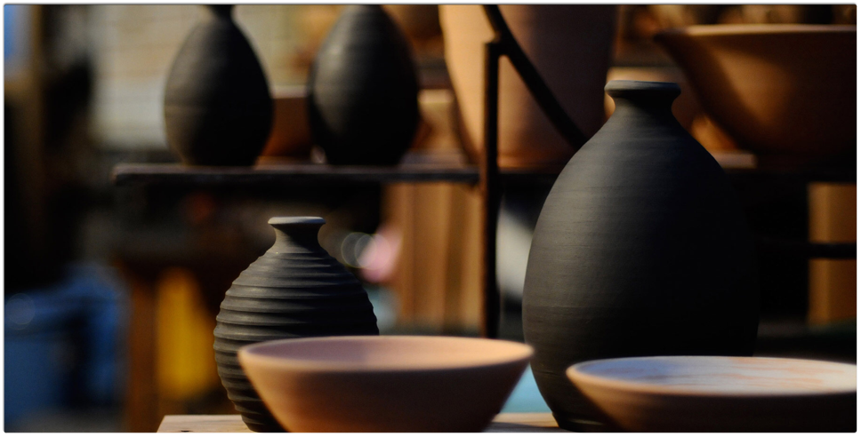
Nesting bowls
Design and media
Rohde and Meunchen

Slide 2
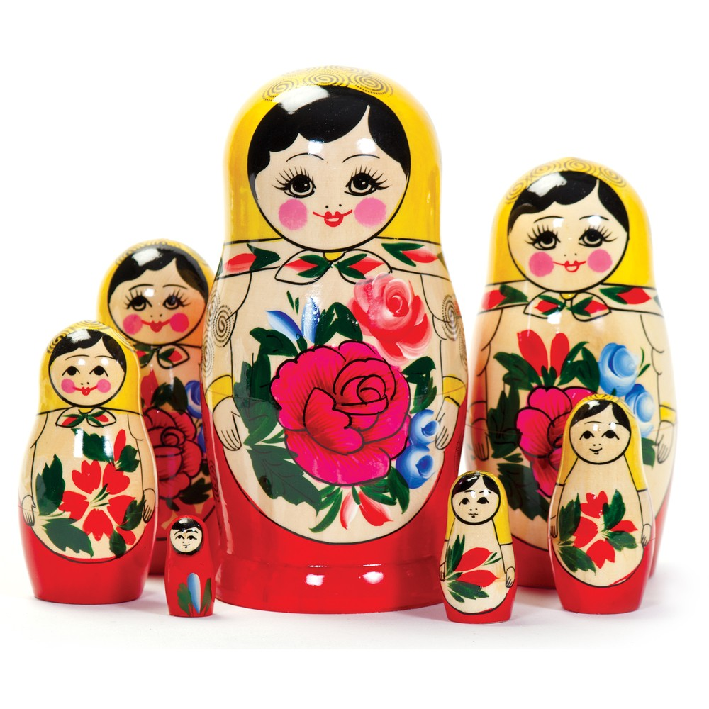
What is nesting?
Nest: to fit an object inside of a larger object
Ex. Matryoshka nesting dolls

Slide 3
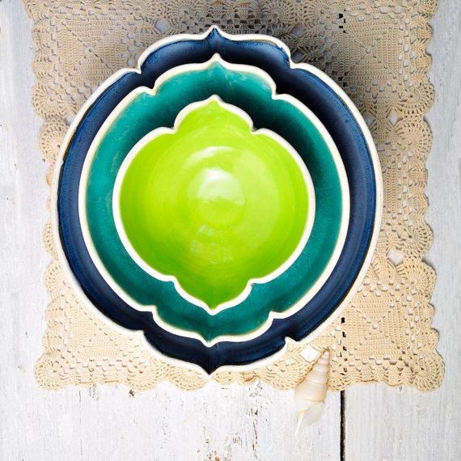

Slide 4
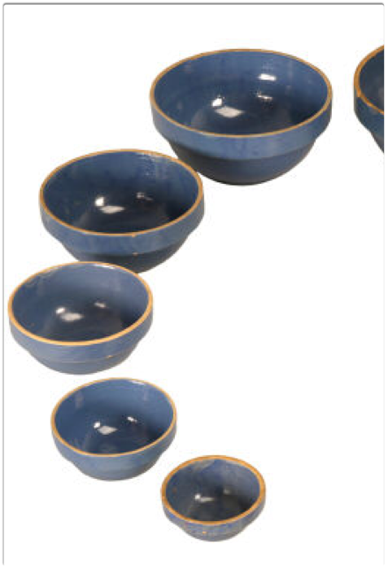
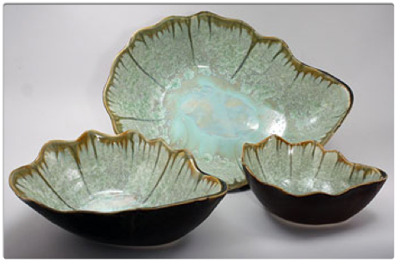
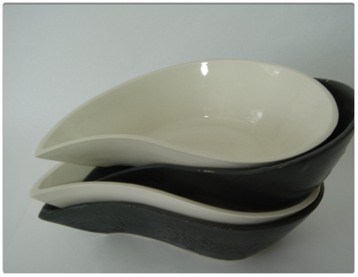

Slide 5
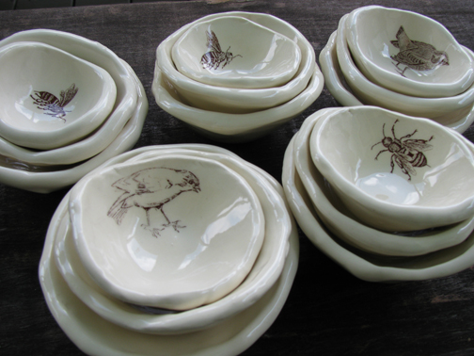
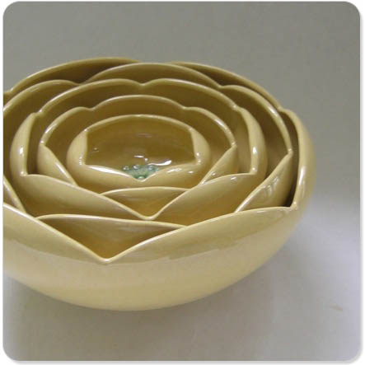
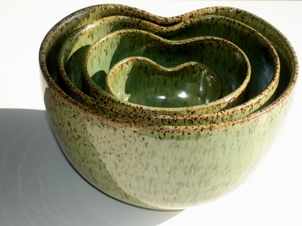
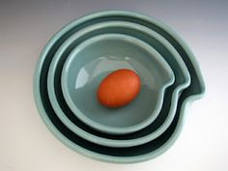

Slide 6
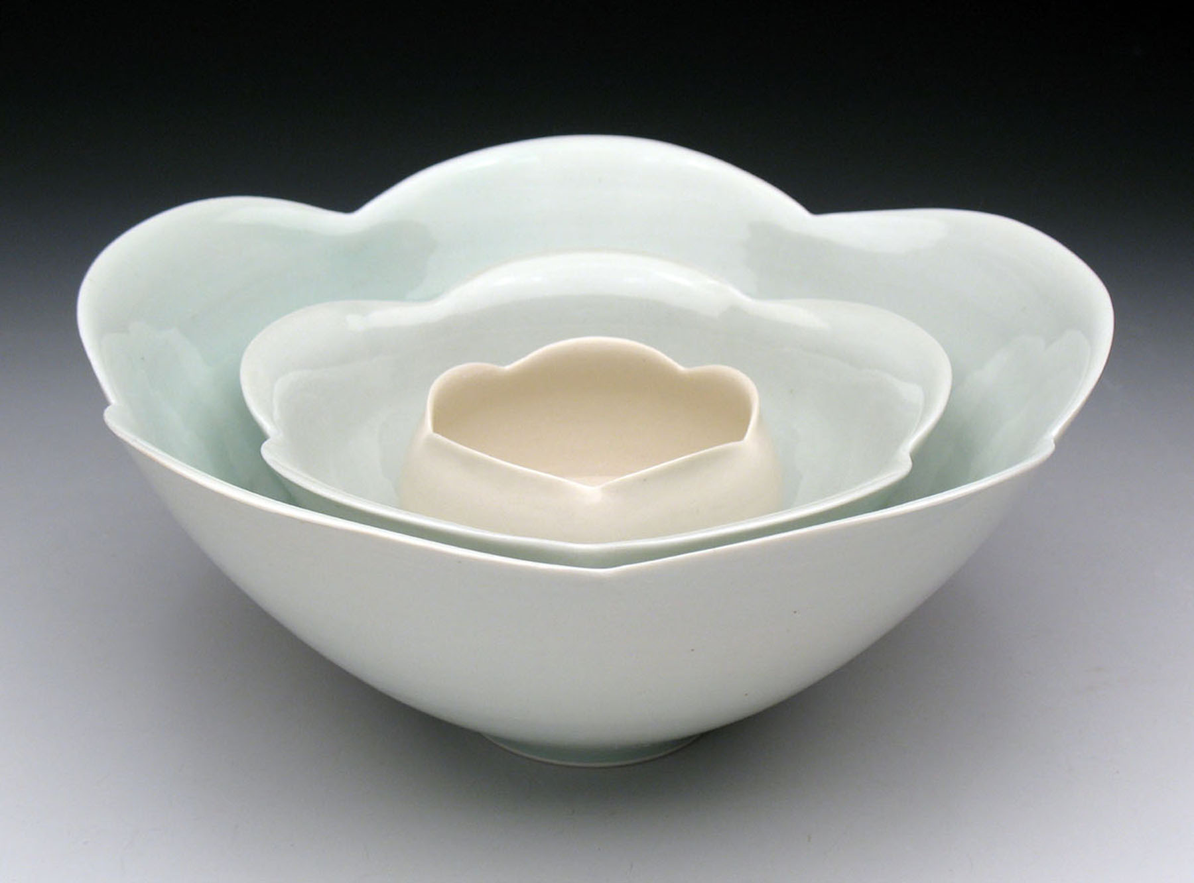

Slide 7
Criteria
3 closely sized bowls, able to nest
Each bowl must be glazed/decorated differently than the other two
Bowls CANNOT be smaller than 1" or bigger than 5" in diameter

Slide 8
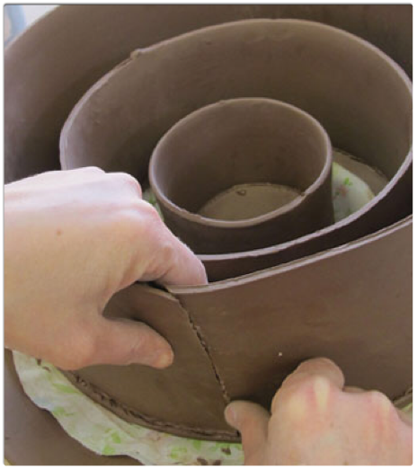
Key terms for ceramics
Slip- a clay and water mixture; used to join two pieces of clay together
Score- technique used to join pieces of clay together
Glaze- coating of enamel applied to a fired piece of clay. Never glaze the bottom of your bowl!
Slab- a flat piece of clay cut into a shape and joined with another piece to make an object
Wedging- a technique of kneading clay to force air bubbles out

Slide 9
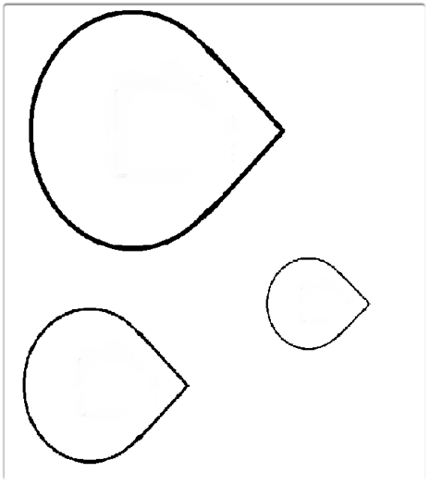
What to do first
Design shape for mouth of bowl
Draw out the selected shape in three different sizes
Must get design approved before clay can be handed out

